Slide 1
Android
Life Cycle

Slide 2

Life Cycle
The steps that an application goes through from starting to finishing
Slightly different than normal Java life cycle due to :
  the difference in the way Android application are defined
  the limited resources of the Android hardware platform

Slide 3
Android Applications
Applications are defined to Android via the android manifest file, located in the root of the Eclipse project definition (AndroidManifest.xml)
Double clicking on the AndroidManifest.xml file in the Eclipse project will open the Manifest editor.
The manifest editor is the normal way of creating and modifying the manifest file (defining the app to the system)

Slide 4
Android Applications
An Android application is a collection of activities, an activity correlates to a screen or form that is presented to the user.
The HelloAndroid is a simple one screen app that is essentially the same as a Java app run in a terminal/command window. Its AndroidManisest.xml file reflects this :

Slide 5
AndroidManifest.xml
<?xml version="1.0" encoding="utf-8"?>
<manifest xmlns:android="http://schemas.android.com/apk/res/android"
package="com.example.helloandroid"
android:versionCode="1"
android:versionName="1.0">
<application android:icon="@drawable/icon" android:label="@string/app_name">
<activity android:name=".HelloAndroid"
android:label="@string/app_name">
<intent-filter>
<action android:name="android.intent.action.MAIN" />
<category android:name="android.intent.category.LAUNCHER" />
</intent-filter>
</activity>
</application>
</manifest>

Slide 6
<manifest>
The manifest tag has the following attributes:
  xmlns ; the name of the namespace (android) and where the DTD for the xml parser is located
  package ; the name of the java package for this application (must have at least two levels)
  android:version ; the version code for this version of the app
  android:versionName ; The version name (for publishing)

Slide 7
<activity>
child tag of <manifest>
need one <activity> tag for each activity of the application
attributes:
  android:name; the name of the activity, this will be used as the name of the Java file and the resulting class
  android:label; a string that we will be able to programatically retrieve the activity name at run time.

Slide 8
<intent-filter>
Child tag of <activity>
First, what’s an intent? In OO-speak an intent is a message sent from one program to another (message dispatcher) to tell the system what to do next. Typically an intent consists of two parts; an action and the data that that action is supposed to use to do it.
When you select an icon on the main page the intent is to run the app associated with that icon
The tag is used to construct an android.content.IntentFilter object to handle a particular android.content.Intent

Slide 9
<action>
child of <intent-filter>
the action we want done:
  Predefined actions of the intent class of android.content ; see the api at:
  http://developer.android.com/reference/android/content/Intent.html

Slide 10
<category>
child of <intent-filter>
additional attributes that can be supplied
LAUNCHER – indicates that it should apper in the launcher as a top level application
see the api documentation for more on intent resolution.

Slide 11
Intents
Commonly used Google application intents
http://d.android.com/guide/appendix/g-app-intents.html
Registry of 3rd party application Intents
http://www.openintents.org/en/intentstable

Slide 12
Whew!
we’ve explained the HelloAndroid manifest file, on to Life Cycle and Life cycle management.

Slide 13
Life Cycle
Each application runs in its own process.
Each activity of an app is run in the apps process
Processes are started and stopped as needed to run an apps components.
Processes may be killed to reclaim needed resources.
Killed apps may be restored to their last state when requested by the user

Slide 14
Management
Most management of the life cycle is done automatically by the system via the activity stack.
The activity class has the following method callbacks to help you manage the app:
  onCreate()
  onStart()
  onResume()
  onPause()
  onStop()
  onRestart()
  onDestroy()

Slide 15
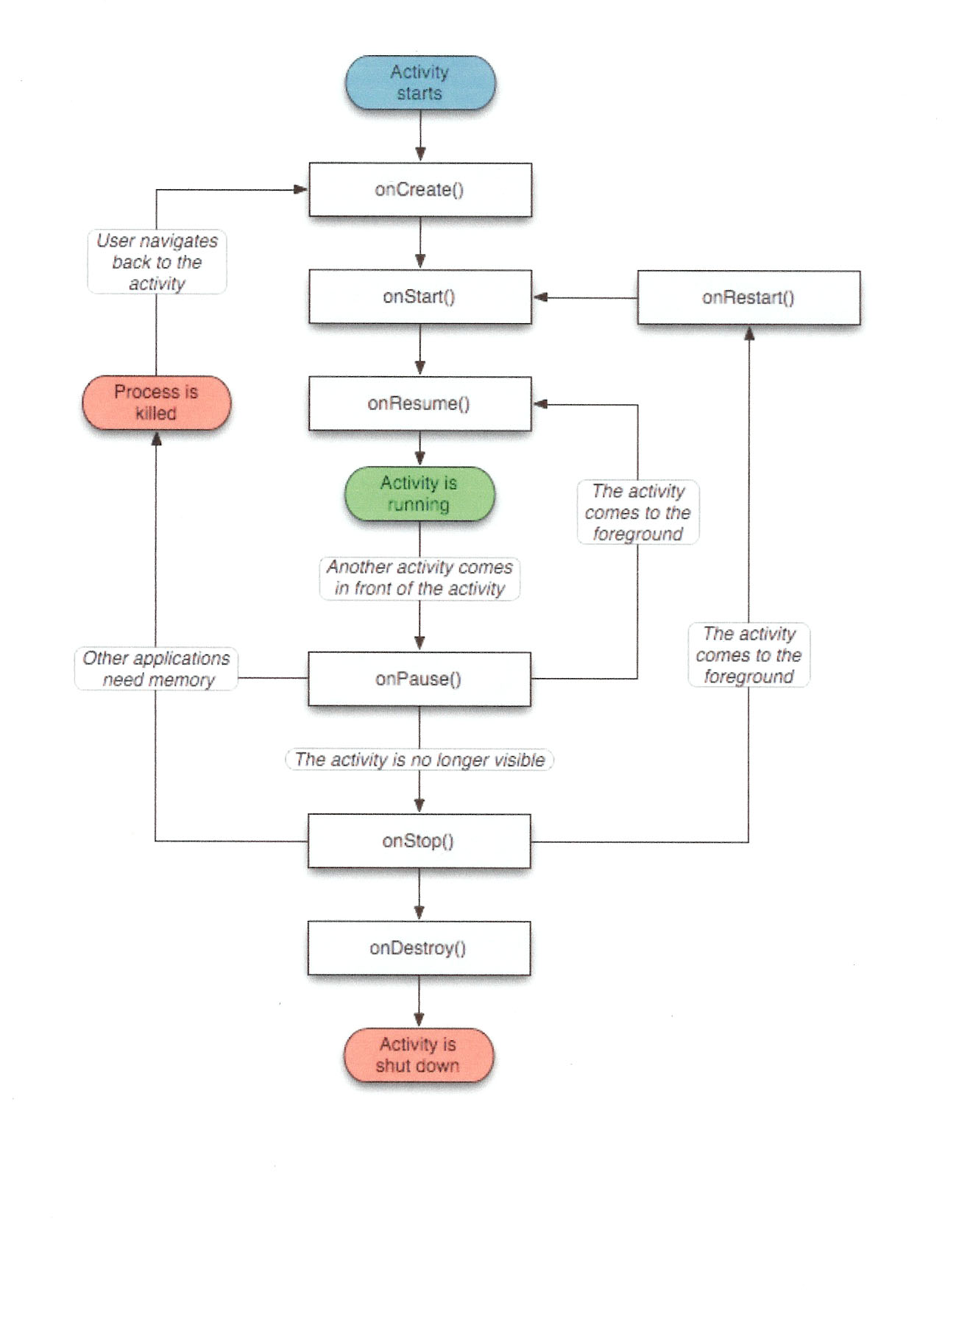

Slide 16
using the callbacks
To use a callback just overload it in your activity java file.
The lifecycle is explained very well here:
http://developer.android.com/training/basics/activity-lifecycle/index.html
The use of the callbacks is explained in the api documentation for the activity class:
http://developer.android.com/reference/android/app/Activity.html

Slide 17
Security Measures
What are the security measures that are taken to make Android secure?
1) Android uses many security measures to keep them away from the hackers. They have designed by making changes to the devices or installing a software service on the mobile.
2) Android application uses sandbox that is very popular and allow limited access to the information that is very private and sensitive for the user.

Slide 18
Security Measures in Android
3) It allows the permissions to be set for the use of the information. The security measures that are provided by android is the use of the encryption of the messages that allow user to remain without worry about there phone security.
4) They also consists of user terms and agreements that also taken care of. Most of the time android doesn't allow other applications to run on their system but it can be done by using different resources that are available on-line. As, android is open source it is not fully secure but lots of security issues are being solved for make it more popular and bug free.

